Slide 1
CS 590 Algorithm
Chapter 4 Balanced Binary Search Trees
Source: Goodrich, M. T., & Tamassia, R. (2015). Algorithm Design and Applications. Hoboken, NJ: Wiley.

Slide 2

Balanced Binary Trees
Presentation for use with the textbook Algorithm Design and Applications, by M. T. Goodrich and R. Tamassia, Wiley, 2015

Slide 3
Application: Real-Time Systems
Real-time systems are computational platforms that have real-time constraints.
They need good performance bounds that hold in the worst case.
May need to perform Nearest Neighbor Query
Example: A list of DNA sequences, ordered lexicographically by mutations from a reference DNA sequence, for a DNA sequencing machine, subject to insertions and deletions.
We need to perform searches based on the ordering (to find nearest neighbors) and we also need to be able to perform insertion and deletion updates, and all these operations need fast worst-case performance.

Slide 4
Solution: Balanced Binary Search Trees
A balanced binary search tree provides a means for maintaining a binary search tree for n elements so the time for searches and updates is O(log n) in the worst-case or in an amortized sense.
9
4
15
2
6
12
21
7

Slide 5
Rank-Balanced Trees
One way to achieve balance is to define an integer rank, r(v), for each node in a binary search tree and maintain certain rules concerning these ranks.
Examples of rank-balanced trees:
AVL Trees
Red-Black Trees
Weak AVL Trees
An example of an AVL tree, where the ranks (which are heights) are shown next to the nodes

Slide 6
Restoring Balance: Trinode Restructuring
Let (a,b,c) be the inorder listing of x, y, z
Perform the rotations needed to make b the topmost node of the three
Single rotation around b
(rotating y over z)
Double rotation around c and a (first rotating x over y and then over z)
a=z
a=z
b=y
T₀
c=y
T₀
c=x
b=x
T₃
T₁
b=y
b=x
T₂
T₃
T₁
T₂
a=z
c=x
a=z
c=y
T₀
T₁
T₂
T₃
T₀
T₁
T₂
T₃

Slide 7
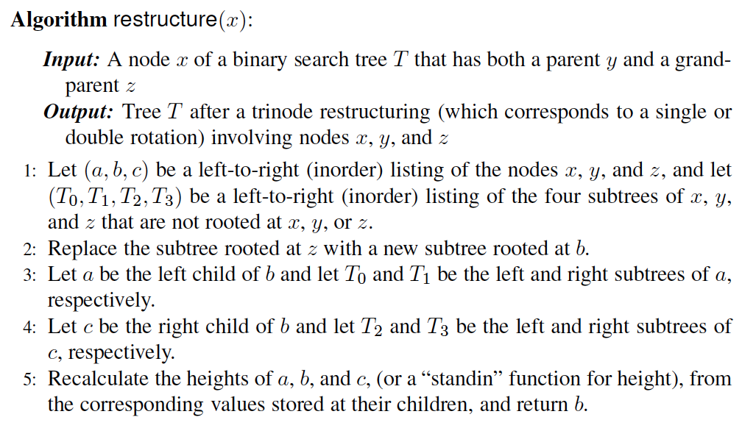
Pseudo-code
The algorithm for doing a trinode restructuring, which is used, possibly repeatedly, to restore balance after an insertion or deletion.

Slide 8
Restructuring (as Single Rotations)
Single Rotations:

Slide 9
Restructuring (as Double Rotations)
double rotations:

Slide 10
Performance
Assume we are given a reference to the node where we are performing a trinode restructure and that the binary search tree is represented using nodes and pointers, that is, a linked-structured binary tree.
A single trinode restructuring takes O(1) time.
A single or double rotation takes O(1) time, because it changes O(1) pointers.
Each kind of rank-balanced tree can do updates in O(log n) time using trinode restructuring operations.

Slide 11
AVL Trees
Presentation for use with the textbook Algorithm Design and Applications, by M. T. Goodrich and R. Tamassia, Wiley, 2015
6
v
3
8
z
4

Slide 12
AVL Tree Definition
AVL trees are rank-balanced trees.
The rank, r(v), of each node, v, is its height.
Rank-balance rule: An AVL Tree is a binary search tree such that for every internal node v of T, the heights (ranks) of the children of v can differ by at most 1.
An example of an AVL tree where the ranks are shown next to the nodes

Slide 13
Height of an AVL Tree
n(2)
3
4
n(1)
Fact: The height of an AVL tree storing n keys is O(log n).
Proof (by induction): Let us bound n(h): the minimum number of internal nodes of an AVL tree of height h.
We easily see that n(1) = 1 and n(2) = 2
For n > 2, an AVL tree of height h contains the root node, one AVL subtree of height h-1 and another of height h-2.
That is, n(h) = 1 + n(h-1) + n(h-2)
Knowing n(h-1) > n(h-2), we get n(h) > 2n(h-2). So
n(h) > 2*n(h-2), n(h) > 4*n(h-4), n(h) > 8*n(h-6), … (by substitution),
n(h) > 2^{i}n(h-2i) till h-2i=1 or 2. Then n(h) >2 ^{h/2-1} *n(1)
Solving the base case we get: n(h) > 2 ^{h/2-1}
Taking logarithms: h < 2log n(h) +2
Thus the height of an AVL tree is O(log n)

Slide 14
Insertion
Insertion is as in a binary search tree
Always done by expanding an external node.
Example:
44
44
17
78
17
78
c=z
a=y
32
50
88
32
50
88
48
62
48
62
b=x
54
before insertion
w
after insertion

Slide 15
Trinode Restructuring
Let (a,b,c) be the inorder listing of x, y, z
Perform the rotations needed to make b the topmost node of the three
Single rotation around b
Double rotation around c and a
a=z
a=z
b=y
T₀
c=y
T₀
c=x
b=x
T₃
T₁
b=y
b=x
T₂
T₃
T₁
T₂
a=z
c=x
a=z
c=y
T₀
T₁
T₂
T₃
T₀
T₁
T₂
T₃

Slide 16
Insertion Example, continued
unbalanced...
T
4
1
44
2
3
x
17
y
62
z
1
2
2
32
50
78
1
1
1
...balanced
48
54
88
T
2
T
T
T
0
1
3

Slide 17
Restructuring (as Single Rotations)
Single Rotations:

Slide 18
Restructuring (as Double Rotations)
double rotations:

Slide 19
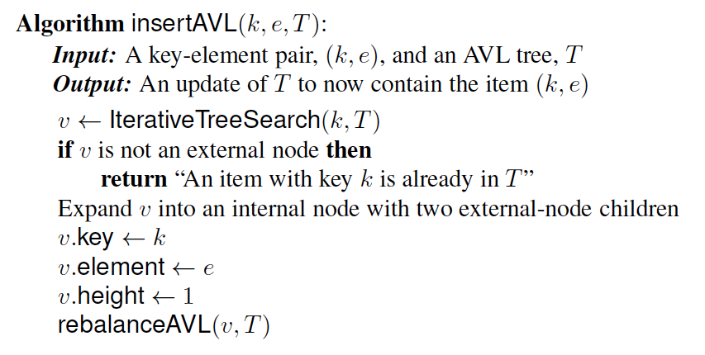
Pseudo-code
Insertion.

Slide 20
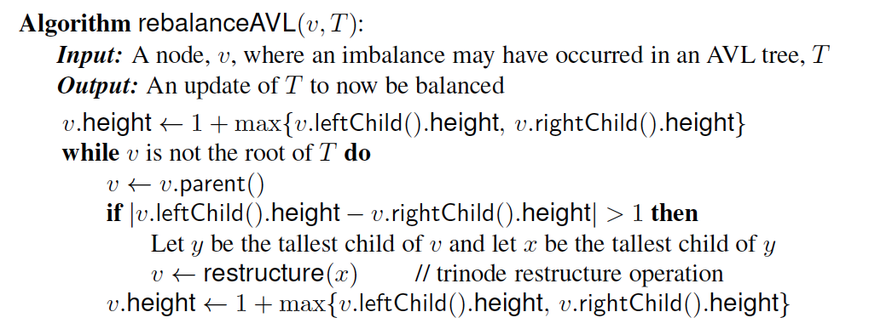
Pseudo-code
Rebalance at a node violating the rank rule.

Slide 21
Removal
Removal begins as in a binary search tree, which means the node removed may cause its parent, w, to create an imbalance.
Example:
44
44
17
62
17
62
32
50
78
50
78
48
54
88
48
54
88
before deletion of 32
after deletion

Slide 22
Rebalancing after a Removal
Let z be the first unbalanced node encountered while travelling up the tree from w. Also, let y be the child of z with the larger height, and let x be the child of y with the larger height
We perform a trinode restructuring to restore balance at z
As this restructuring may upset the balance of another node higher in the tree, we must continue checking for balance until the root of T is reached
a=z
62
44
w
b=y
44
78
17
62
c=x
17
50
88
50
78
48
54
48
54
88

Slide 23
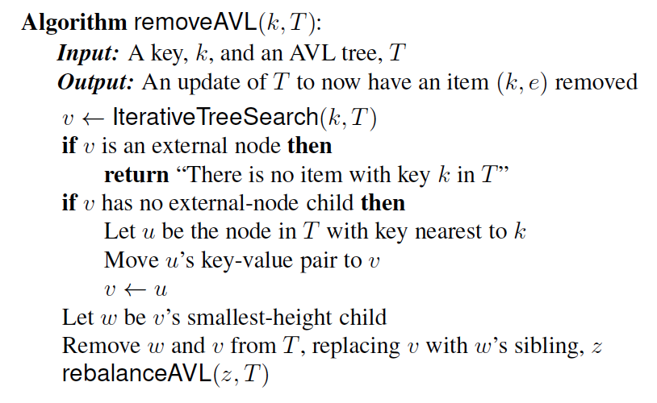
Pseudo-code
Removal

Slide 24
AVL Tree Performance
AVL tree storing n items
The data structure uses O(n) space
A single restructuring takes O(1) time
using a linked-structure binary tree
Searching takes O(log n) time
height of tree is O(log n), no restructures needed
Insertion takes O(log n) time
initial find is O(log n)
restructuring up the tree, maintaining heights is O(log n)
Removal takes O(log n) time
initial find is O(log n)
restructuring up the tree, maintaining heights is O(log n)

Slide 25
Red-Black Trees
Presentation for use with the textbook Algorithm Design and Applications, by M. T. Goodrich and R. Tamassia, Wiley, 2015
6
v
3
8
z
4

Slide 26
Red-Black Trees
A red-black tree is a binary search tree that satisfies the following properties:
Root Property: the root is black
External Property: every external node (leaf) is black
Internal Property: the children of a red node are black
Black-depth Property: all the leaves have the same black depth
9
4
15
2
6
12
21
7

Slide 27
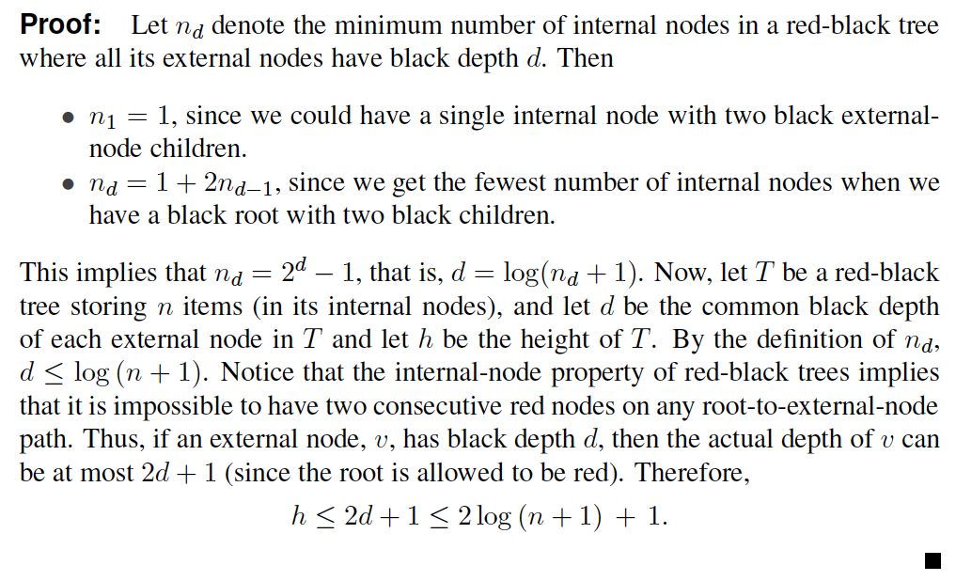
Height of a Red-Black Tree
Theorem: A red-black tree storing n items has height O(log n).
By the above theorem, searching in a red-black tree takes O(log n) time.

Slide 28
Red-Black Tree Performance
By the above theorem, searching in a red-black tree takes O(log n) time in the worst case.
Insertions and deletions can also be done in O(log n) although the details are somewhat complicated and skipped in this course; but can be done easier on Red-Black Equivalent.
9
4
15
2
6
12
21
7

Slide 29
Red-Black Equivalent Trees
For a tree with ranks on its nodes, for each node v in T other than the root, we define the rank difference of v as the difference between the rank of v and the rank of v’s parent.
A tree is a red-black equivalent if the ranks assigned to its nodes satisfy the following properties:
External Property: every external node (leaf) has rank 0 and its parent, if it exists, has rank 1.
Parent Property: the rank difference of every node, other than the root, is 0 or 1.
Grandparent Property: any node with rank difference 0 is either a child of the root or its parent has rank difference 1.

Slide 30
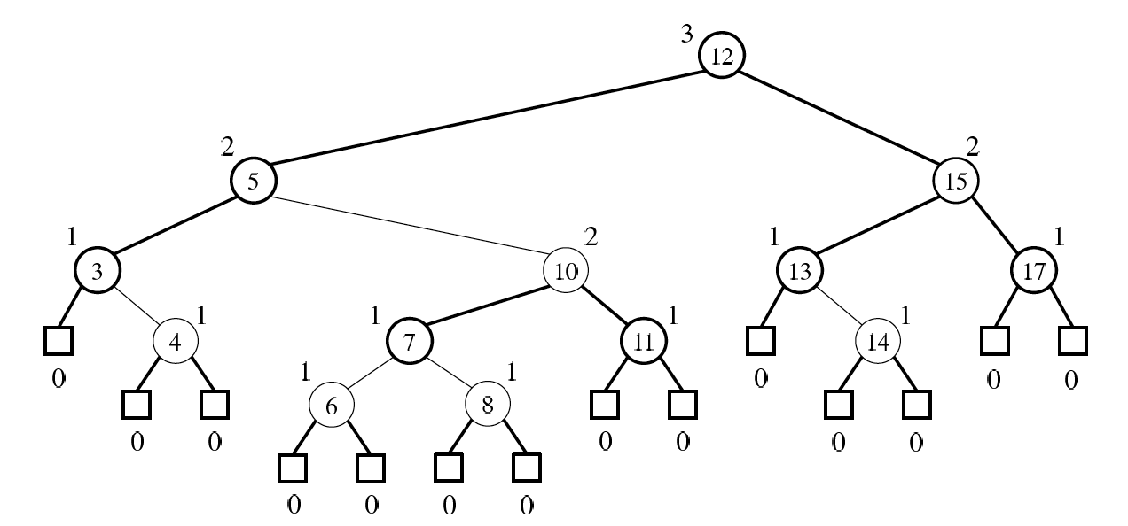
Example
A red-black tree with ranks

Slide 31
Red-Black Trees are Red-Black-Equivalent Trees
Theorem: Every red-black tree has a red-black-equivalent rank assignment.
Proof: Suppose T is a red-black tree. Without loss of generality, we can assume the root of T is black.
Define the black height of each node v in T as the number of black descendants of v (not counting v) on a path from v to an external node. Now, assign ranks as follows:
Rank-Assignment Rule: Give each black node, v, in T a rank, r(v), equal to its black height, and give each red node, v, a rank, r(v), equal to the rank of its (black) parent.
Then this assignment of ranks satisfies all the properties for being red-black-equivalent. In particular:
Every external node will have rank 0 and a parent of rank 1.
The rank differences of every node will be 0 or 1.
Any node with rank difference 0 will have a parent with rank difference 1.

Slide 32
Red-Black-Equivalent Trees are Red-Black Trees
Theorem: Every tree with a red-black-equivalent rank assignment can be colored as a red-black tree.
Proof: Suppose T is a binary tree with a red-black-equivalent rank assignment. To come up with a coloring of T, use the following:
Color-Assignment Rule: If a node has rank difference 0, then color it red; otherwise, color it black.
Then this assignment of ranks satisfies all the properties for being a red-black tree. In particular:
Every external node will be colored black.
Every red node will have a black parent.
Every external node will have the same black depth, by a simple induction proof.

Slide 33
About Stevens
A premier, private research university with a mission to inspire, nurture and educate leaders in tomorrow’s technology-centric environment while contributing to the solution of the most challenging problems of our time

